Slide 1

Summary of the ML Process
Professor Bo Liu
James Watt School of Engineering

Slide 2
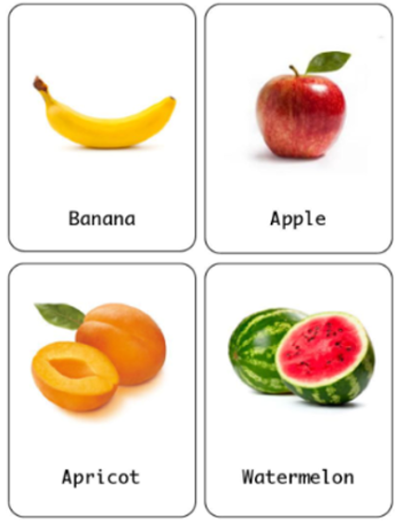
The ML overview
ML overview
Data representation
Select ML algorithms
Model training
Model evaluation

Slide 3
An overview of ML
What is ML?
Traditional Programming vs. ML.
Types of ML:
  supervised, unsupervised, semi-supervised.
Supervised learning:
  Regression
  Classification

Slide 4
Data and data representation in ML
ML overview
Data representation
Select ML algorithms
Model training
Model evaluation

Slide 5
Data and data representation in ML
Basic concepts in ML:
  Dataset, sample, feature, label, model, training set, test set.
Data types in ML:
  Numerical data: discrete, continuous
  Categorical data: binary, nominal, ordinal
Encoding of nominal data:
  One-hot encoding
  Dummy encoding

Slide 6
Select ML models
ML overview
Data representation
Select ML algorithms
Model training
Model evaluation

Slide 7
Select ML models
Parametric models:
  Linear regression (LR) and its principles
  Financial prediction with LR
  MATLAB implementation of LR
Non-parametric models:
  KNN and its principles
  Classification with KNN
  MATLAB implementation of KNN

Slide 8
Training of ML models
ML overview
Data representation
Select ML algorithms
Model training
Model evaluation

Slide 9
Training of ML models
Loss function:
  Regression: MSE, MAE
  Classification: cross entropy
Loss function minimization
  Gradient descent algorithm
Three kinds of gradient descent
  Batch gradient descent
  Stochastic gradient descent
  Mini-batch gradient descent

Slide 10
Evaluation of ML models
ML overview
Data representation
Select ML algorithms
Model training
Model evaluation

Slide 11
Evaluation of ML models
Bias and Variance: definition, influence on prediction error
Underfitting: detection, avoidance
Overfitting: detection, avoidance
K fold cross-validation:
  principles
  bias-variance estimation by k fold cross-validation
Bias-variance trade-off
  principles
  good fitting

Slide 12




Thanks!
#UofGWorldChangers
@UofGlasgow

